Slide 1
SOFTWARE DEVELOPMENT 3
Interfaces

Slide 2
Interfaces
Most of the time, you will use API supplied Java interfaces
Sometimes you will want to design your own
You would write an interface if you want classes of various types to all have a certain set of capabilities

Slide 3
What are interfaces for?
Reason 1: A class can only extend one other class, but it can implement multiple interfaces
  This lets the class fill multiple “roles”
  In writing Applications, it is common to have one class implement several different listeners
  Example:
  class MyApp extends App
  implements ActionListener, KeyListener {
  ...
  }
Reason 2: You can write methods that work for more than one kind of class

Slide 4
Import Interface Example 1
An interface is like an abstract class with nothing but abstract methods and final static data members.
All methods and data of an interface are public.
For example, you can define an ImportDuty interface with the single method calculateDuty().
public interface ImportDuty {
double calculateDuty ( );
}

Slide 5
Interfaces
You might want to use this interface on many different classes, cars among them but also for clothes, food, electronics and more.
It would be inconvenient to make all these objects derive from a single class. Furthermore, each different type of item is likely to have a different means of calculating the tariff. Therefore you define an Import interface and declare that each class implements the Import interface.

Slide 6
Interfaces
The syntax is simple.
The Import interface's access modifier is public.
This means that the interface is accessible outside the package containing it.
If you omit the keyword public, your interface is only accessible from within its containing package.
Almost all interfaces will be public.
The interface keyword takes the place of the class keyword.

Slide 7
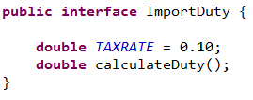
Import Interface 2 Example 1
data members are final and static by default
The methods in an interface are always public and abstract, so you do not need to specify them as such
The method will be implemented in each class that implements the interface.

Slide 8
Interfaces
You can declare many different methods in an interface. These methods must be overridden in the class that implements the interface.
An interface can also have fields, but if so they must be public, final and static (in other words constants).
A class can implement more than one interface.
If the class implements more than one interface, then all of the interfaces are listed after the implements keyword.

Slide 9
Interfaces vs. Inheritance
Use Interfaces to share common behaviour(only method headers)
One class can implement multiple interfaces
    E.G. class Person implements Driver,Bike
Using inheritance to share common code among related classes
  Data
  Methods
A single subclass can extend at most one superclass
    class PTEmployee extends Employee
A subclass “isa” superclass
  A dog “isa” animal
The “isa” relationship does not have to exist between the interface and the class that implements it

Slide 10
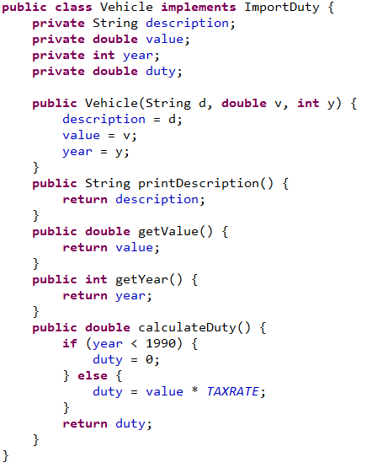
Implementing Interfaces
To make use of the "ImportDuty" interface, you need to create a class that will declare that it implements Import. Note the use of the keyword implements
Here is one such class Vehicle which includes the calculateDuty() method.

Slide 11
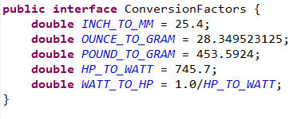
Implementing Interfaces-Example 2
This initial interface contains only constants:
Here we have five constants for conversions of various kinds - remember that these are public, static, and final by default.
You might also want to define an interface containing methods for conversion

Slide 12
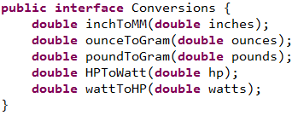
Implementing Interfaces-Example 2
You can extend one interface based on another by using the keyword extends to identify the base interface name.
For example, the interface Conversions would perhaps be more useful if it contained the constants that the interface ConversionFactors contains

Slide 13
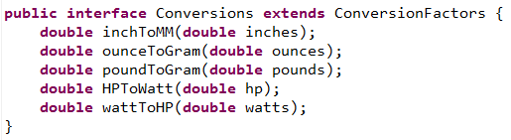
Implementing Interfaces-Example 2
We could do this by defining the interface Conversions as:
Now the interface Conversions also contains the members of the interface ConversionFactors.
Any class implementing the Conversions interface will have the constants from ConversionFactors available to implement the methods.
The interface ConversionFactors is referred to as a super-interface of the interface Conversions.

Slide 14
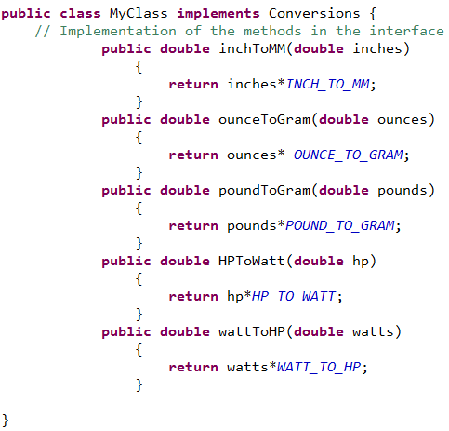
Implementing Interfaces-Example 2
All the constants defined in the interface ConversionFactors are available in MyClass as though they were data members of the class.
You can reference them freely in any of the methods in the class.
Because they are public they will also be accessible members of objects of type MyClass.
When the interface contains
Methods, we have to
implement the methods that
are in the interface.

Slide 15
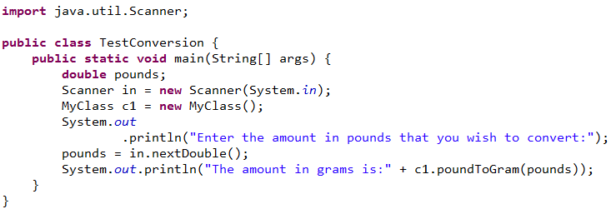
Implementing Interfaces-Example 2
Program Output:
Enter the amount in pounds that you wish to convert:
80
The amount in grams is:36287.392

